Slide 1
Cryptography Evolution
Chinthan B

Slide 2
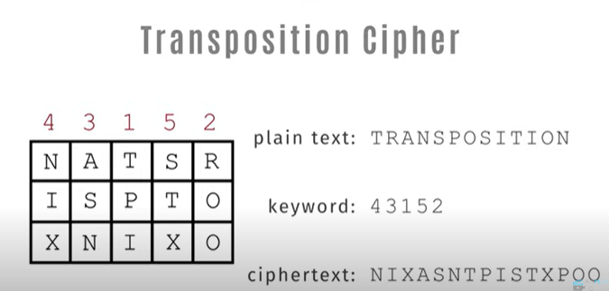

Early history
1. Scytale
In ancient Greece, scytale was a common cipher instrument, particularly used by Spartans. It was made out of a piece of parchment that was coiled around a rod and, on which a transposition cipher had been used to write a message. The message remained unreadable, unless it was wrapped around a rod with the proper circumference.
2. Ceaser Cipher
The Caesar Cipher is a kind of monoalphabetic substitution cipher that encrypts and decrypts data using a cipher alphabet. An alphabet used for ciphers is identical to one used for ordinary text, with the exception that the letters are flipped left or right by a predetermined amount. It has been named after Julius Caesar.

Slide 3
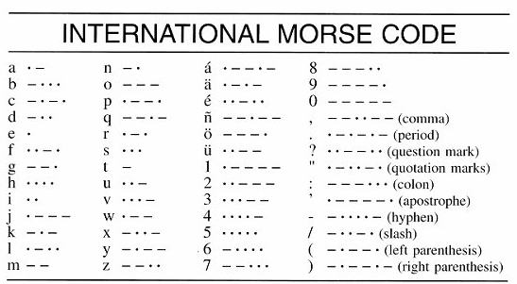
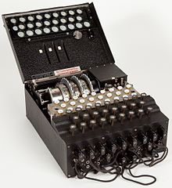
After technological advancement
1. Morse Code And The Telegraph
The electric telegraph was created and patented by Samuel Morse. An operator at one telegraph station punched a switch to transcribe messages into Morse code that could be delivered elsewhere in the world. An operator at a different telegraph station would hear these sounds and record the messages that went along with them.
2. WWII And The Enigma Machine
One or more rotors move to create a new rotor configuration that will encode one letter as another when a key on the keyboard is pushed.

Slide 4
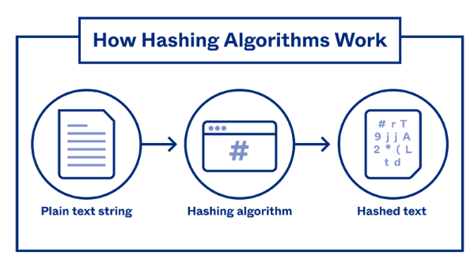
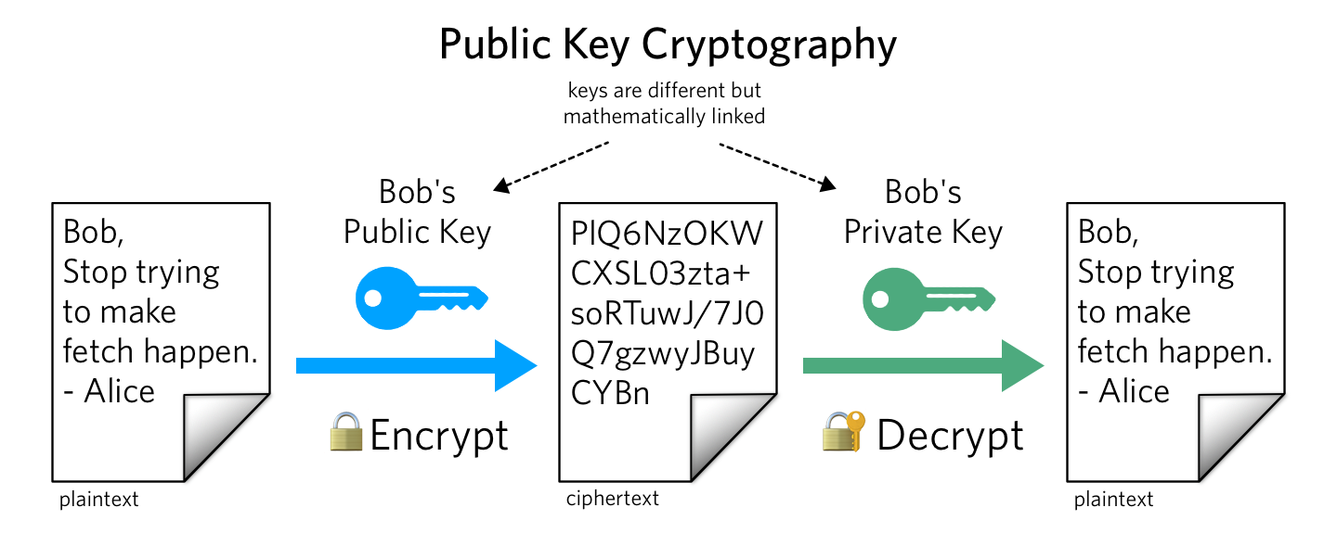
Modern
1. Public Key Cryptography
Using two distinct keys to encrypt or sign data and making one of them, the public key, publicly accessible is known as public key cryptography. The term "private key" refers to the other key. Only the private key can be used to decrypt data that has been encrypted using the public key.
Example: RSA algorithm.
Hashing Algorithm
All hashing algorithms are:
Mathematical
Uniform
Consistent
One way

Slide 5
Thank you

